Slide 1
Module 3: Lesson 4 MapReduce Examples

Slide 2
MapReduce Example
Objective
Method
Input
Record 1: hello world
Record 2: hadoop hello
Assume
The input file holds two records as follows:
Except for a map and reduce function which we will provide, we will accept default plugin functions
We have configured two mapper and two reducers
We want to use the MapReduce framework running on a cluster to perform the count operation
Count the number of occurrences of each unique word in a text file held in HDFS

Slide 3
MapReduce Phases and Steps
We will discuss the Combine step or Combiner function as a MapReduce optimization later

Slide 4
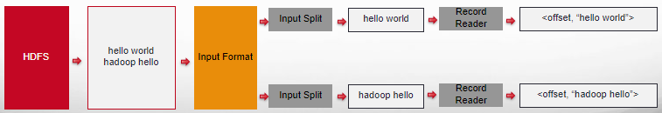
Input Step
Splits up the input file(s) into logical InputSplits, each of which is then assigned to an individual Mapper
Input split size is usually equal to the HDFS block size but this is configurable
Provides the RecordReader implementation to be used to obtain input records from the logical InputSplit for processing by the Mapper
The RecordReader makes each record available to the mapper as a key value pair of the form <record-offset, “record-content”>

Slide 5
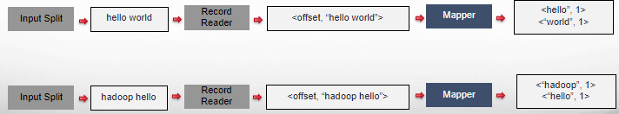
Map Step
The Mapper is called to process each key value pair obtained by the Record Reader from the split to which it is assigned
The mapper parses the record content of the key value pair from a string of words into individual words
It then emits a new key value pair for each individual word of the form” <”word”, 1>
This is a idiom of the use of MapReduce will becomes clear only when later steps are understood

Slide 6
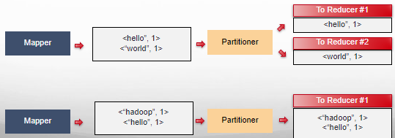
Partition Step
If there is more than one Reducer the Partitioner determines to which Reducer (partition) each intermediate key-value pair is assigned
By default, the Partitioner assigns each key value pair to a Reducer (partition) based on a hash function applied to the key. Note, the key value pairs in a partition are sorted ascending by key
In this way the Partitioner ensures that all key-value pairs with the same word (key) are assigned to the same Reducer (partition)
It is possible to provide a customized Partitioner that can apply other assignment criteria to each key value pair

Slide 7
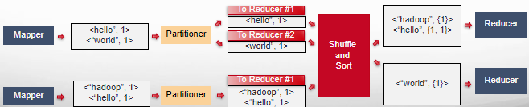
Shuffle and Sort Step
Each Reducer node fetches (shuffles) key value pairs assigned to it from the Mapper nodes.
These retrieved key value pairs are then merged together and sorted by key ascending again
Key value pairs are grouped so all values that share the same key are together as a collection
If we have <“hello”, 1> and <“hello”, 1> as two distinct key value pairs
Then they are coalesced into a single key value pair <“hello”, {1, 1}>
If we have <“world”, 1> as a single unique key value pair
Then it is coalesced so its value is a collection as follows <“world”, {1}>

Slide 8
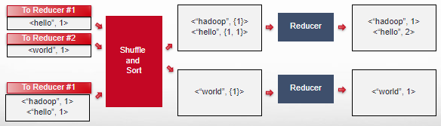
Reduce Step
Each Reducer function processes the key-value pairs assigned to it
Then each Reducer generates a new set of output key-value pairs
In this case, the Reducers sum up the values (1’s) for each key (word) to determine the number of occurrences of each word

Slide 9
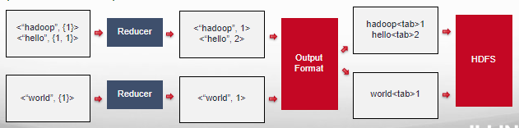
Output Step
Provide the RecordWriter to be used to write out the output files of the job
Each Reducer writes to a separate data sink (HDFS file, S3 object, etc.)
The default OutputFormat is TextOutputFormat, which writes (key, value) pairs on individual lines of text files
Its keys and values can be of any type since TextOutputFormat turns them to strings by calling toString() on them and, by default, each key-value pair is separated by a tab character
KeyValueTextOutputFormat is used for reading these output text files since it breaks lines into key-value pairs based on a separator

Slide 10
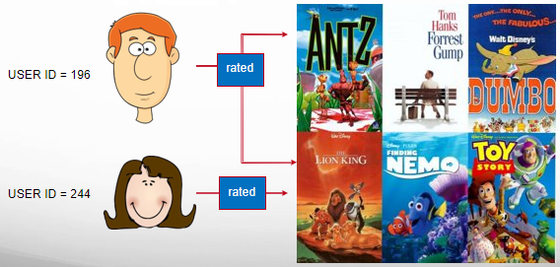
Let’s illustrate with another example
How many movies did each user rate in the MovieLens data set?

Slide 11
MovieLens Data
How many movies did each user rate in the MovieLens data set?
Movie rating:
1 to 5 stars
USER ID | MOVIE ID | RATING | TIMESTAMP
196 | 242 | 3 | 881250949
186 | 302 | 3 | 891717742
196 | 377 | 1 | 878887116
244 | 51 | 2 | 880606923
166 | 346 | 1 | 886397596
186 | 474 | 4 | 884182806
186 | 265 | 2 | 881171488
For instance, user 196 rated two movies

Slide 12
Map Phase
Map users to the movies they watched
For each record output the key value pair
<User ID, Movie ID>
USER ID | MOVIE ID | RATING | TIMESTAMP
196 | 242 | 3 | 881250949
186 | 302 | 3 | 891717742
196 | 377 | 1 | 878887116
244 | 51 | 2 | 880606923
166 | 346 | 1 | 886397596
186 | 474 | 4 | 884182806
186 | 265 | 2 | 881171488
<User ID, Movie ID>
<196, 242>
<186, 302>
<196, 377>
<244, 51>
<166, 346>
<186, 274>
<186, 265>
Mapper

Slide 13
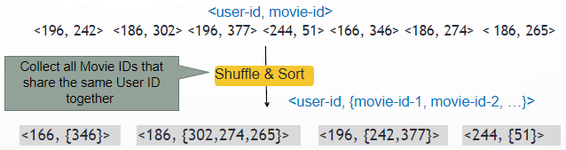
Shuffle and Sort
Group values sharing the same key and sort by key
After shuffle and sort, all values associated with the same key are grouped together
The key-value pairs are presented to reducers in sorted order by their keys

Slide 14
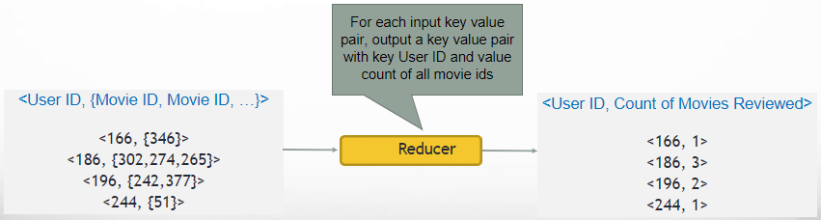
Reduce Phase
Count the number of movies that each user reviewed

Slide 15
Putting it All Together
USER ID | MOVIE ID | RATING | TIMESTAMP
196 | 242 | 3 | 881250949
186 | 302 | 3 | 891717742
196 | 377 | 1 | 878887116
244 | 51 | 2 | 880606923
166 | 346 | 1 | 886397596
186 | 474 | 4 | 884182806
186 | 265 | 2 | 881171488
MAPPER
<196, 242> <186, 302> <196, 377> <244, 51> <166, 346> <186, 274> <186, 265>
SHUFFLE AND SORT
<186, {302,274,265}> <196, {242,377}>
<166, {346}>
<244, {51}>
REDUCER
<166, 1> <186, 3> <196, 2> <244, 1>

